Slide 1
Logical Thinking Process (Week #2)
Disampaikan oleh:
Tim Pengajar MPPI Semester Genap 2017/2018
Course: Research Methodology and Scientific Writing
Faculty of Computer Science
University of Indonesia, Feb 2018

Slide 2
Review Session 1: What’s Research?
Langkah-2 yang sistematis, objektif, dan logis disebut metodologi.
“A research methodology will consist of phases, sub-phases, which will guide the researchers in their choice of the methods, techniques, procedures, tools, etc., that might be appropriate at each stage of the research and also help them plan, manage, control and evaluate the progress of research”.
It needs a logical thinking - thinking that is coherent and logical

Slide 3
Session Objectives: Logical Thinking
To understand logical reasoning using inductive and deductive approaches
To understand how to build “argument”
To understand how to analyze and interpret “argument”
To understand how to draw conclusion using logical reasoning

Slide 4
Motivations behind Logic
How can you draw conclusion?
How much premises you need to draw conclusion?
Where do you find the information to build premise?
How valid your premise?
How do you generate premise?

Slide 5
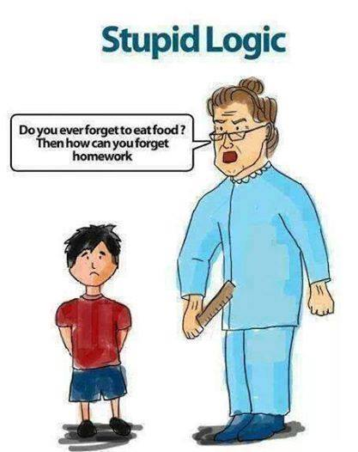
Apa yang salah dari percakapan di atas?
Apa yang betul dari percakapan di atas?
http://www.indianfunnyimages.com/

Slide 6
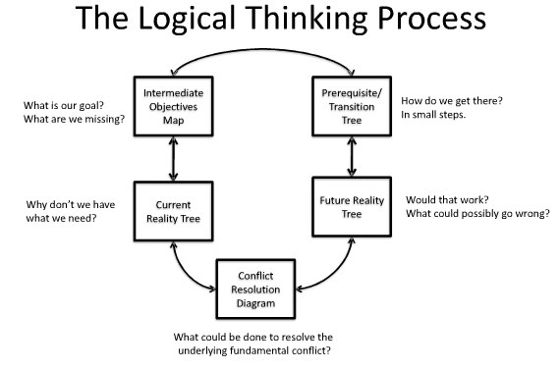
1
2
3
5
4
Source: Rotnetix.com

Slide 7
Why We Need Logical Thinking?
To form and evaluate our “believe” on a statement.
To determined logically an objectively whether a statement is valid or not.
To draw a conclusion from a logical thinking processes.
Logical thinking consists on input, process, and output.
What is the difference between “believe on a statement” versus
“believe on God?”

Slide 8
Definition of Logic
Logika (logic) merupakan suatu studi tentang metode-metode dan prinsip-prinsip yang digunakan dalam membedakan penalaran (reasoning) yang tepat dari penalaran yang tidak tepat[Hayon, Y.P., 2000].
Penalaran (reasoning, jalan pikiran) adalah suatu proses berpikir yang berusaha menghubung-hubungkan fakta-fakta atau evidansi-evidansi yang diketahui menuju kepada suatu kesimpulan[Keraf, Gorys, 1994].
Gunakan definisi agar kita mempunyai persepsi yang sama

Slide 9
Elements of Logic
Dalam logika terdapat beberapa elemen yang terkait seperti:
Argumen (argument),
Premis-premis (premises),
Proposisi (propositions),
Inference,
dan Conclusion.
Implikasi lainnya adalah kita dapat mulai dari premis yang salah, memprosesnya melalui inference yang valid dan menuju pada kesimpulan yang benar.

Slide 10
Pengertian Argument
Suatu argumen disebut argumen yang sah, atau valid, atau logis, jika kesimpulannya ditarik mengikuti hukum-hukum logika.
Suatu argumen dikatakan valid atau sahih apabila kesimpulan yang terdapat pada argumen tersebut mempunyai kaitan dengan premis-premis sedemikian rupa sehingga kesimpulan itu benar apabila premis-premis yang mendahuluinya benar.
Peranan logika menjadi penting karena pada dasarnya, logika mengevaluasi validitas suatu argumen, sedangkan argumen merupakan salah satu syarat bagi pengembangan ilmu.
Tanpa menggunakan logika dalam mengemukakan penalarannya, para ilmuwan tidak mungkin dapat mengembangkan ilmunya.

Slide 11
Argument
“a reason or set of reasons given with the aim of persuading others that an action or idea is right or wrong”. (logic.webcrawler.com/)
Logic is the study of argument
Example of a non-debatable argument:
Pollution is bad for the environment
Example of a debatable argument:
At least 25 percent of the government budget should be spent on limiting pollution.
Argument digunakan dalam karya ilmiah

Slide 12
Premise
Premis adalah pernyataan yang benar, yang kebenarannya sudah kita ketahui sebelumnya berdasarkan atas argumen sebelumnya, atau terbukti sendiri (self-evident), atau yang kita percaya sebagai benar walaupun belum terbukti.
A premise is a statement that an argument claims will induce or justify a conclusion. In other words: a premise is an assumption that something is true.

Slide 13
Contoh Premise
“Identical twins often have different IQ test scores. Yet such twins inherit the same genes. So environment must play some part in determining IQ”.
The argument consists of three statements:
Identical twins often have different IQ scores.
Identical twins inherit the same genes.
So environment must play some part in determining IQ.
The first two statements in this argument give reasons for accepting the third. In logic terms, they are said to be premises of the argument, and the third statement is called the argument's conclusion."
(Alan Hausman, Howard Kahane, and Paul Tidman, Logic and Philosophy: A Modern Introduction, 12th ed. Wadworth, Cengage, 2013)

Slide 14
Proposition…(Source: Wikipedia)
In logic and philosophy, the term proposition refers to either (a) the "content" or "meaning" of a meaningful declarative sentence or (b) the pattern of symbols, marks, or sounds that make up a meaningful declarative sentence.
The meaning of a proposition includes having the quality or property of being either true or false, and as such propositions are claimed to be truthbearers.

Slide 15
Inference (Source: Wikipedia)
Inference is the act or process of deriving logical conclusions from premises known or assumed to be true.^{[1]} The conclusion drawn is also called an idiomatic. The laws of valid inference are studied in the field of logic.
Human inference (i.e. how humans draw conclusions) is traditionally studied within the field of cognitive psychology; artificial intelligence researchers develop automated inference systems to emulate human inference. Statistical inference allows for inference from quantitative data.

Slide 16
Definition…..
Inductive logical of thinking
The principle of reasoning to a conclusion about all the members of a class from examination of only a few members of the class
Reasoning from particular to general
Deductive logical of thinking
Reasoning from general to particular
Conclusion follows from the premises
The premises logically imply the conclusion

Slide 17
"A deductive argument," says Manuel Velasquez, "is one that is supposed to show that if its premises are true then its conclusion necessarily has to be true.
“An inductive argument” is one that is supposed to show that if its premises are true then its conclusion is probably true.
(Philosophy: A Text with Readings, 2017).

Slide 18
Features of Inductive Reasoning
Evidence
Premises
Conclusion
Argument

Slide 19
Schematic Form of a Simple Inductive Argument
Inductive argument consists of premises and conclusion
Premise can be found through observation (data gathering an analysis)
Structure of argument:
First Premise
Second Premise
n… Premise
Conclusion

Slide 20
Inductive Argument
It will be possible for a good inductive argument to have a false conclusion even though all its premises are true (what does it mean?, give examples, lihat contoh berikut)
Science uses inductive reasoning all the time (explain!)
Reasoning from sample, Reasoning from examples (the different sample vs. example?)
Knowledge expanding (how knowledge expanding?)
Using inductive argument

Slide 21
Contoh Logika Induktif
Apel 1 keras, warnanya hijau, dan rasanya masam
Apel 2 keras, warnanya hijau, dan rasanya masam
Apel 3 keras, warnanya hijau, dan rasanya masam
_______________________________________
Kesimpulannya: Semua apel keras, warnanya hijau, dan rasanya masam
“Bisa jadi, kesimpulan ini salah karena sample yang diambil tidak representatif?”
Hati-2 dalam memilih sample, bisa mengarah ke manipulasi data,
misalnya, dalam pooling pendapat (pilkada, merek dagang, dll)

Slide 22
Bahaya Menggunakan Logika Induktif
Terlalu cepat menarik kesimpulan yang berlaku umum, sementara jumlah kasus yang digunakan dalam premis kurang memadai.
Premis yang digunakan kurang memenuhi kaedah-kaedah keilmiahan.
Dipilih berdasarkan pilih kasih, seharusnya randomize
Instrument yang digunakan diragukan validitas dan reliabilitasnya.

Slide 23
Logika Deduktif
Penalaran deduktif berdasarkan pengetahuan sebelumnya yang bersifat umum, dan menyimpulkan pengetahuan baru yang bersifat khusus.
Bersifat silogisme: argumen yang terdiri dari premis-premis dan kesimpulan.
Hubungan antara premis-premis dengan kesimpulan merupakan hubungan yang tidak terpisahkan satu sama lain.
Intinya terletak pada tepat tidaknya “hubungan” antara premis-2 dengan kesimpulan.
Bersifat a priori: premis-premis tidak memerlukan pengamatan inderawi atau empiris

Slide 24
Contoh Logika Deduktif
Semua manusia berakal budi
Cecep adalah manusia
_____________________________
Kesimpulan: Cecep berakal budi
Latihan…berikan contoh2 lain

Slide 25
Ciri-ciri Logika Deduktif
Analitis: kesimpulan ditarik hanya dengan menganalisa proposisi-proposisi atau premis-premis yang sudah ada.
Tautologis: kesimpulan yang ditarik sesungguhnya secara tersirat sudah terkandung dalam premis-premisnya.
A priori: kesimpulan ditarik tanpa pengamatan inderawi atau obeservasi empiris.
Argumen deduktif selalu dapat dinilai valid atau tidak valid.

Slide 26
Contoh Logika Deduktif
Premis:
1. Jarak Jakarta-Surabaya kurang dari 750 km, atau antara 750 dan 1500 km, atau lebih besar dari 1500 km.
2. Jarak Jakarta-Surabaya tidak lebih kecil dari 750 km.
3. Jarak Jakarta-Surabaya tidak lebih besar dari 1500 km.
Kesimpulan:
Maka jarak Jakarta-Surabaya antara 750 km sampai 1500 km.
Apakah argumen di atas sahih (valid)?

Slide 27
Logical Fallacies
Logical fallacies, Logical errors in scientific writings.
Logic is the set of rules by which one can formulate convincing arguments
It is "the science of argument."
When presenting an argument, one takes a set of premises that are proven to be true, and uses logic to show how they prove a certain "foregone conclusion.“
If an argument contains a fallacy, then the conclusion will not necessarily be proven.

Slide 28
General Categories of Fallacies
Material fallacies
Fallacies of relevance
Verbal fallacies.

Slide 29
Material fallacies
Anyone presenting an argument uses both premises and presuppositions.
Premises are the starting points of an argument which can be proven.
Presuppositions are the underlying assumptions which cannot be proved or disproved.
Presuppositions are inevitable because of human finiteness and bias.
Since the presuppositions cannot be proved or disproved, they must be taken on faith.
Material fallacies arise out of the fabric (or 'material') used to express an argument.
Example: Stealing is a crime. Stealing is a part of baseball. Therefore baseball is a criminal activity.

Slide 30
Fallacies of Relevance
Fallacies of relevance deal principally with the relationship between the premise/evidence, and the conclusion of the argument.
For example, someone who tries to prove a point using emotion, or who proves the wrong point, commits a fallacy of relevance.
The point that is proved is usually "an issue about which people have strong opinions, so that no one notices how their attention is being diverted" from the real issue.

Slide 31
Verbal Fallacies
Verbal fallacies deal principally with the misusage of words.
An argument which contains "improper or ambiguous use of words" is invalid.
Here are some descriptions and examples of verbal fallacies.

Slide 32
The Importance of Understanding Logical Fallacies
Identifying logical fallacies is an important skill for everyone to have.
It is not only helps one to avoid accepting false conclusions, but it also helps one to learn better reasoning and debating skills.
The process of looking for logical fallacies can help one to better understand the subject one is reading about or discussing.
Knowing how to identify fallacies and how to avoid using them, can make one better prepared to refute false ideas and present the truth.

Slide 33
Exercise your thought….
Exercise yourself to build argument
Give examples of inductive reasoning
Give examples of deductive reasoning
What are the advantages and disadvantages of using inductive and deductive reasoning?
How do you apply logical reasoning in advancing knowledge?

